Slide 1



Flutter
Mohit Malik

Slide 2


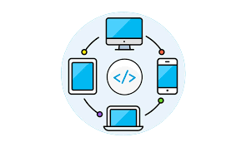

Developed By Google
Flutter is an open-source mobile application development framework developed by Google.
Introduction to Flutter
Uses Dart
It uses the Dart programming language and allows for the creation of high-performance, visually appealing applications.
Multi-Platform
Reach your Users on every screen. Through flutter you can develop application for mobile (Android, IOS), Web, Desktop (Windows, Mac, Linux).
Reactive Programming
Flutter uses a reactive programming model, which means that changes made to the user interface are automatically updated in real-time.

Slide 3
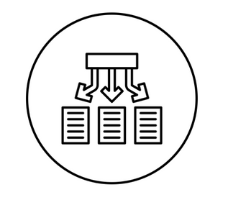

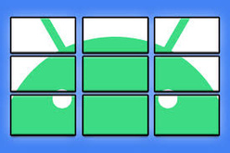
Why Flutter?
Hot Reload
Single Codebase
Pre-Built widgets
Flutter provides a hot reload feature, which allows developers to see changes to the code in real-time
It provides a single codebase for both Android and iOS, which reduces development time and cost.
Flutter has a large number of pre-built widgets and tools that can be easily customized

Slide 4

Flutter Architecture
Widget Tree
Flutter follows a reactive programming model and uses the widget tree architecture to build user interfaces.
Combination of Widgets
The widget tree consists of individual widgets, which are then combined to form more complex widgets.
Properties & Behaviour
Each widget has its own properties, state, and build method, which determine its appearance and behavior.

Slide 5
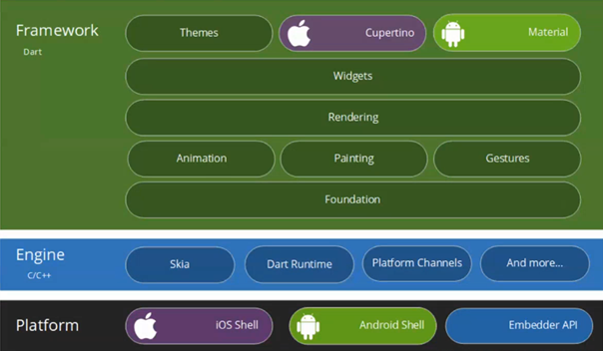
Flutter Architecture

Slide 6
Dart Programming Language
Dart is a general-purpose programming language used for developing Flutter applications.
Dart has a concise syntax and is easy to learn for developers who are familiar with other programming languages such as Java and JavaScript.

Slide 7
Flutter Vs Others
Performance
Flutters tops all of the other apps in performance as it uses dart programming language that is compiled directly into the native ARM code for both iOS and Android.
Others -
React Native
Xamarin
Ionic
Development Time
Flutter' development speed is very faster due to pre-build widgets, packages & third party libraries, community & integration.
Easy To Learn
Dart is very similar to Java or Javascript so developers can easily learn or switch to Flutter

Slide 8

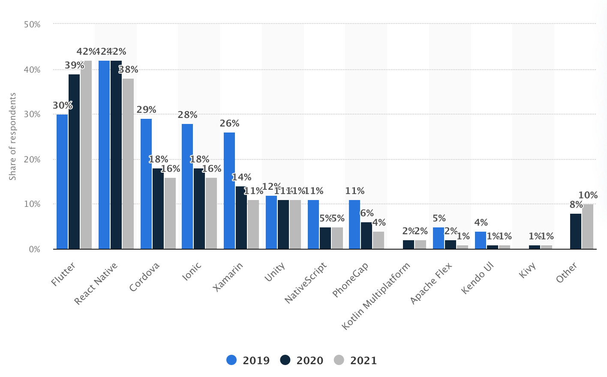
Comparison
The latest research from Statista places Flutter as the leading cross-platform mobile development framework in 2021

Slide 9

Flutter Tools & Ecosystem
Rich Ecosystem
Flutter has a rich ecosystem of tools and plugins that can be used to enhance the development process.
Set of command-line tools
Flutter provides a set of command-line tools for building and testing applications.
Large Number of Plugins
The Flutter community has developed a large number of plugins and packages that can be used to add functionality to applications.

Slide 10
Oppurtunities
Jobs Available
There are thousands of job vacancies available for flutter in today's date. Even Companies hire interns train them for becoming flutter developer.
Salary
Flutter Developer Average Salary Around a beginner-level Flutter developer may earn around $38,000 per annum, a mid-level Flutter developer with a few years of experience around $67,000, and a Flutter developer with several years of experience and expertise around $96,000 per annum

